Slide 1
C as Implemented in Assembly Language

Slide 2
Overview
We program in C for convenience
There are no MCUs which execute C, only machine code
So we compile the C to assembly code, a human-readable representation of machine code
We need to know what the assembly code implementing the C looks like
To use the processor efficiently
To analyze the code with precision
To find performance and other problems
An overview of what C gets compiled to
C start-up module, subroutines calls, stacks, data classes and layout, pointers, control flow, etc.

Slide 3
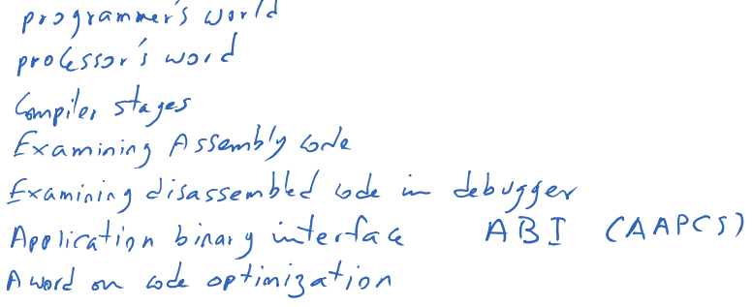
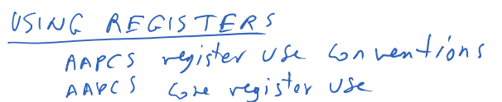

Slide 4
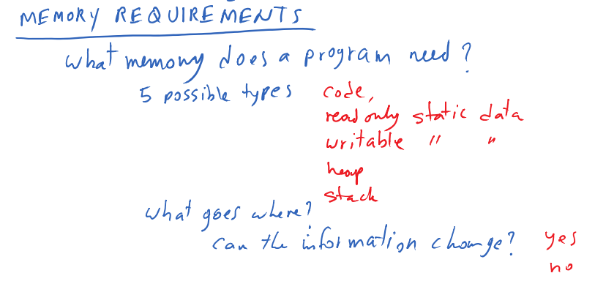
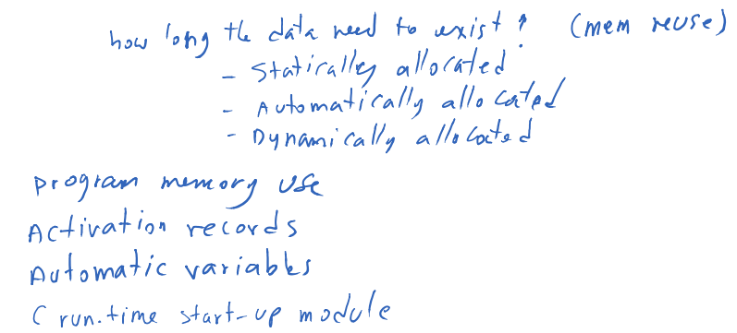

Slide 5
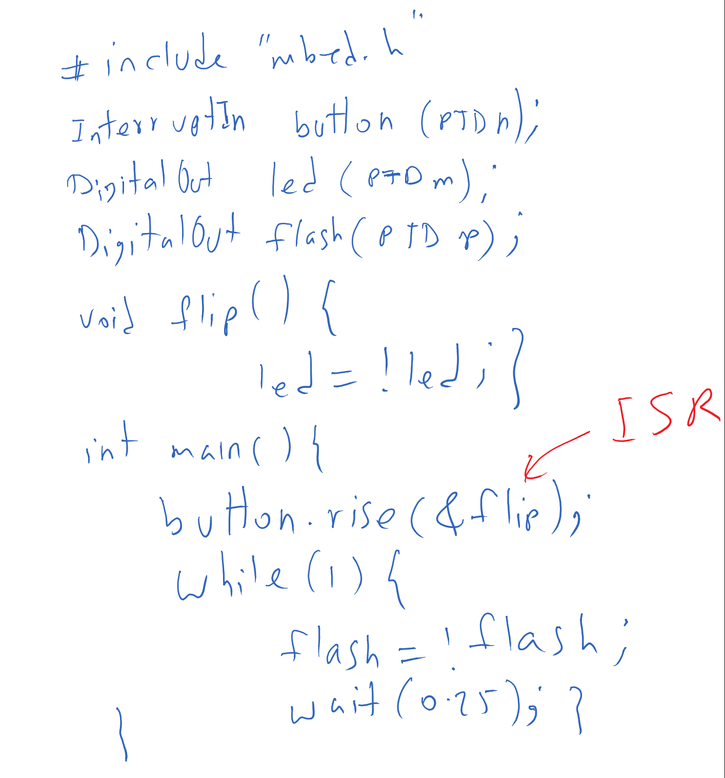

Slide 7
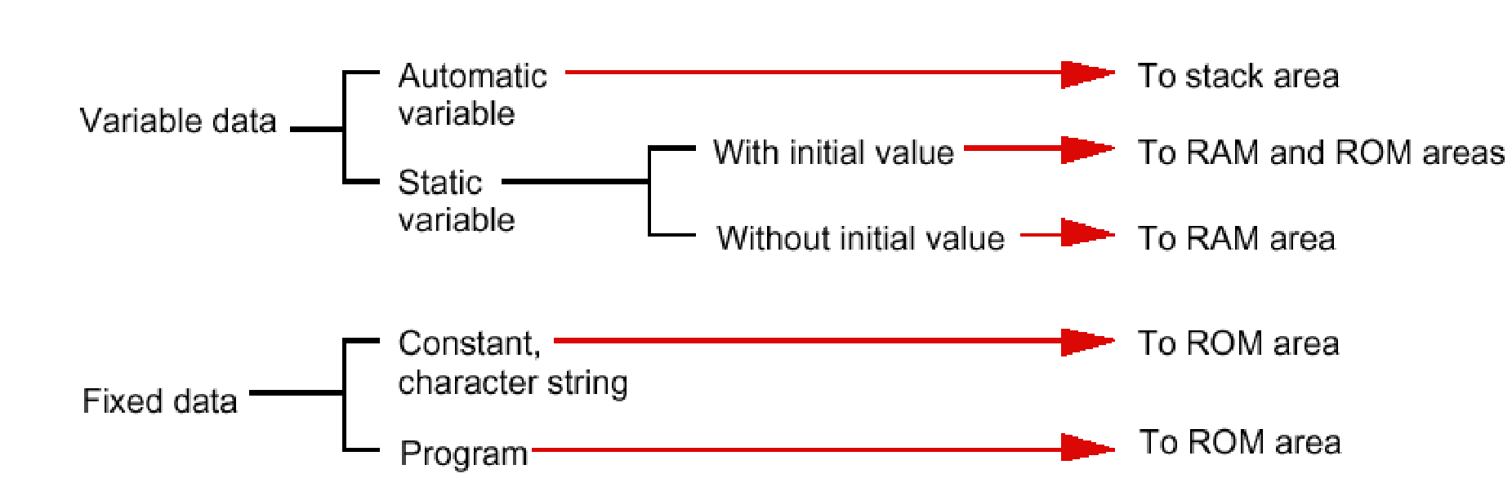

Slide 8
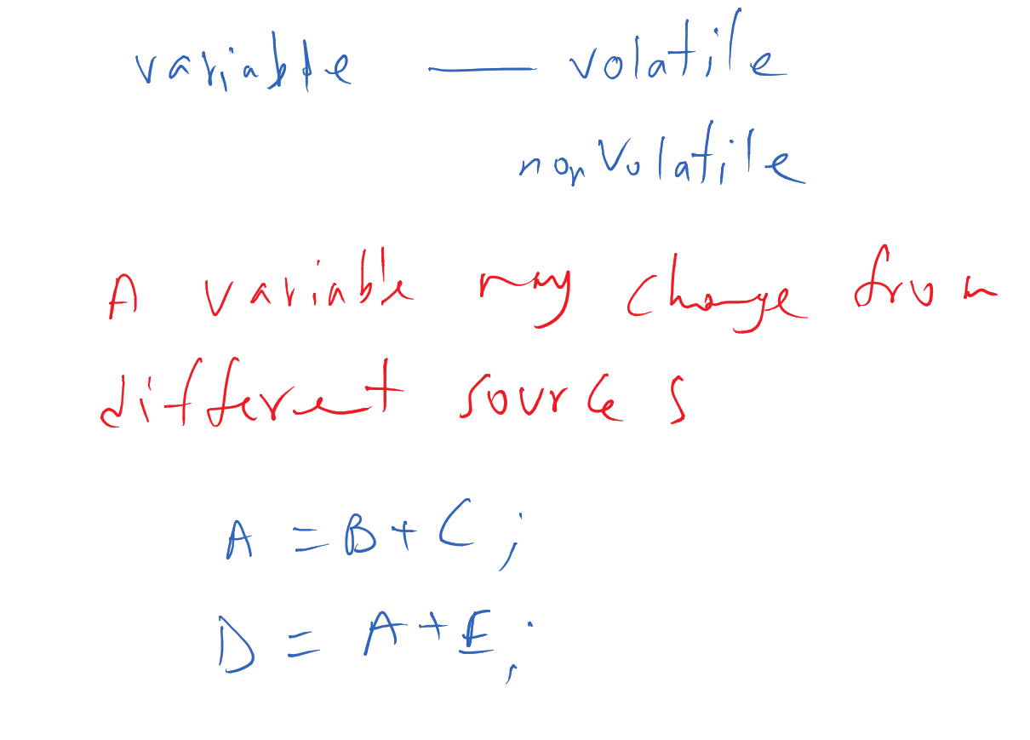

Slide 9
Volatile Data
Compilers assume that variables in memory do not change spontaneously, and optimize based on that belief
Don’t reload a variable from memory if current function hasn’t changed it
Read variable from memory into register (faster access)
Write back to memory at end of the procedure, or before a procedure call, or when compiler runs out of free registers
This optimization can fail
Example: reading from input port, polling for key press
while (SW_0) ; will read from SW_0 once and reuse that value
Will generate an infinite loop triggered by SW_0 being true
Variables for which it fails
Memory-mapped peripheral register – register changes on its own
Global variables modified by an ISR – ISR changes the variable
Global variables in a multithreaded application – another thread or ISR changes the variable

Slide 10
The Volatile Directive
Need to tell compiler which variables may change outside of its control
Use volatile keyword to force compiler to reload these vars from memory for each use
volatile unsigned int num_ints;
Pointer to a volatile int
volatile int * var; // or
int volatile * var;
Now each C source read of a variable (e.g. status register) will result in an assembly language LDR instruction
Good explanation in Nigel Jones’ “Volatile,” Embedded Systems Programming July 2001

Slide 11
Non-Atomic Shared Data
void GetDateTime(DateTimeType * DT){
DT->day = TimerVal.day;
DT->hour = TimerVal.hour;
DT->minute = TimerVal.minute;
DT->second = TimerVal.second;
}
Want to keep track of current time and date
Use 1 Hz interrupt from timer
System
TimerVal structure tracks time and days since some reference event
TimerVal’s fields are updated by periodic 1 Hz timer ISR
void DateTimeISR(void){
TimerVal.second++;
if (TimerVal.second > 59){
TimerVal.second = 0;
TimerVal.minute++;
if (TimerVal.minute > 59) {
TimerVal.minute = 0;
TimerVal.hour++;
if (TimerVal.hour > 23) {
TimerVal.hour = 0;
TimerVal.day++;
… etc.
}

